Slide 1
Spring Object/XML mapping using JAXB XML binding framework – Annotation Configuration
Using the Spring’s Object/XML Mapping, we can convert Object to XML or vice verse
XML Marshalling – Convert Object to XML.
XML UnMarshalling – Convert XML to Object.

Slide 2
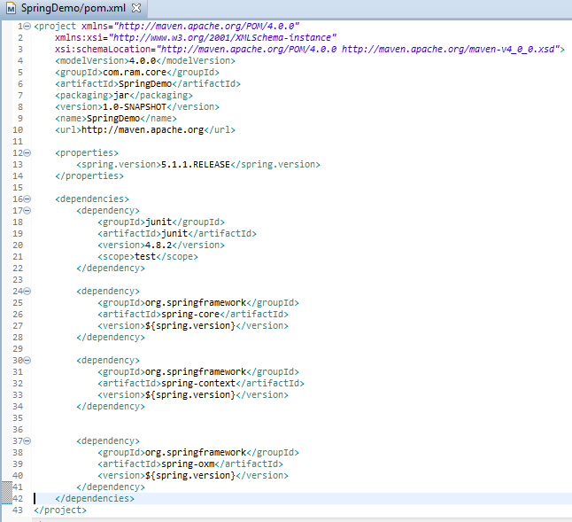
Spring Object/XML mapping using JAXB XML binding framework – Annotation Configuration

Slide 3
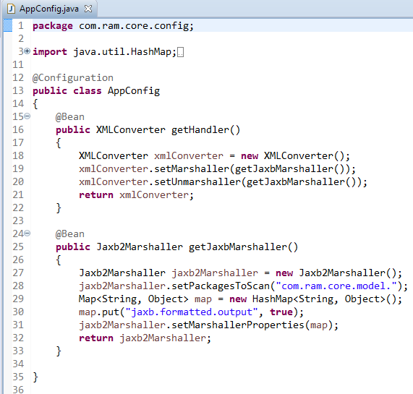
Spring Object/XML mapping using JAXB XML binding framework – Annotation Configuration
Spring OXM provides Jaxb2Marshaller instance which is used to create instances of Marshaller and Unmarshaller. We can set properties in Jaxb2Marshaller for pretty printing, encoding etc. of XML
No model. remove

Slide 4
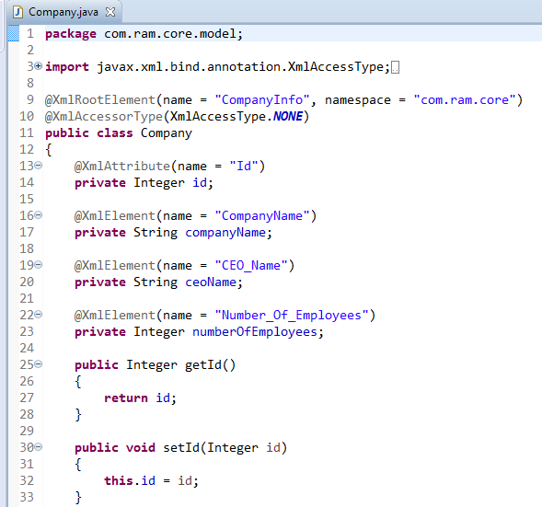

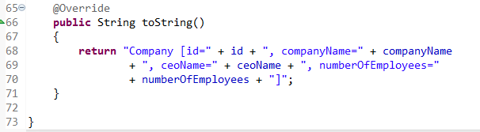
Spring Object/XML mapping using JAXB XML binding framework – Annotation Configuration
For XML and Java object mapping, java provides different annotations like @XmlRootElement, @XmlAccessorType, @XmlAttribute and @XmlElement.
To get java properties as XML attribute, use @XmlAttribute and for XML sub tag we need to use @XmlElement annotation on properties.
….
….

Slide 5
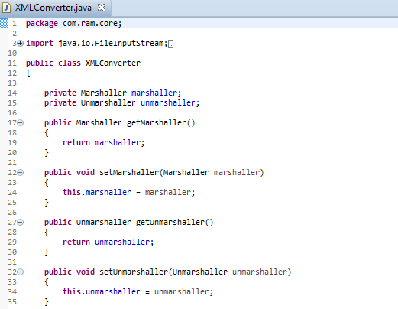
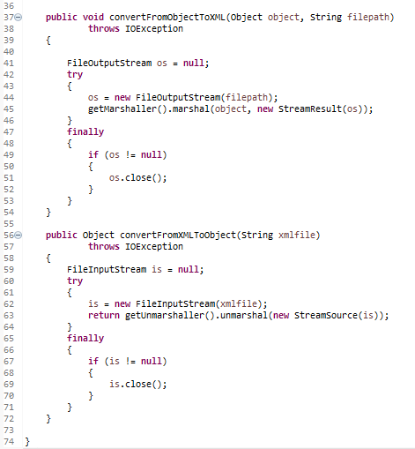
Spring Object/XML mapping using JAXB XML binding framework – Annotation Configuration

Slide 6
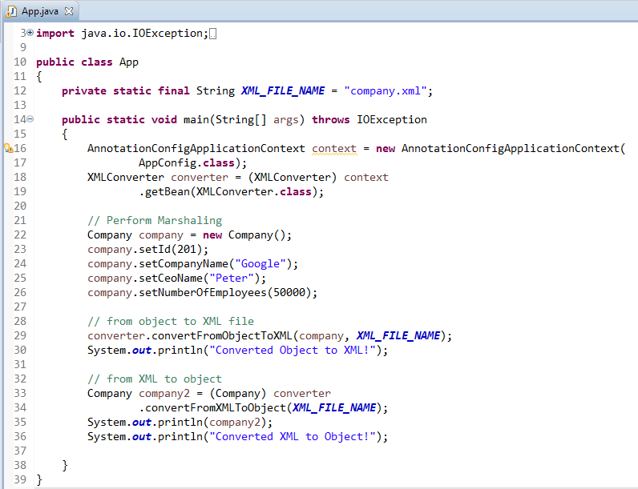
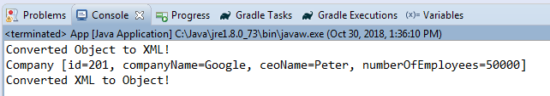
Spring Object/XML mapping using JAXB XML binding framework – Annotation Configuration

Slide 7
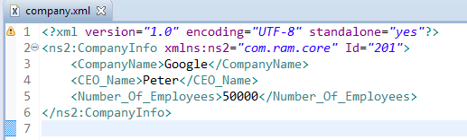
Spring Object/XML mapping using JAXB XML binding framework – Annotation Configuration
“company.xml” is generated in your project root folder

